Slide 1


Lecture 8
Produced by Dr. Worldwide
Welcome to the 305
~
~

Slide 2

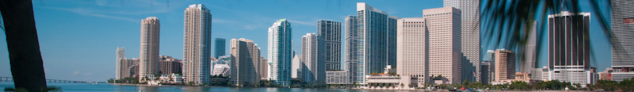
Integer Programming
Prior linear programs have decision variables that are naturally integer-valued
Optimal solutions are commonly not integer-valued
Simply rounding up or down could lead to non-optimal solutions or could lie in an infeasible region
Algorithms exist to handle this common problem
Models where some/all the variables are required to be integer-valued are known as integer programming models

Slide 3
Integer Programming
Total integer models are linear programming models where all the decision variables must be integer-valued
0-1 integer models are linear programming models where all the decision variables must take the values 0 or 1
Mixed integer models are linear programming models where some of the decision variables must be integer valued while others do not

Slide 4
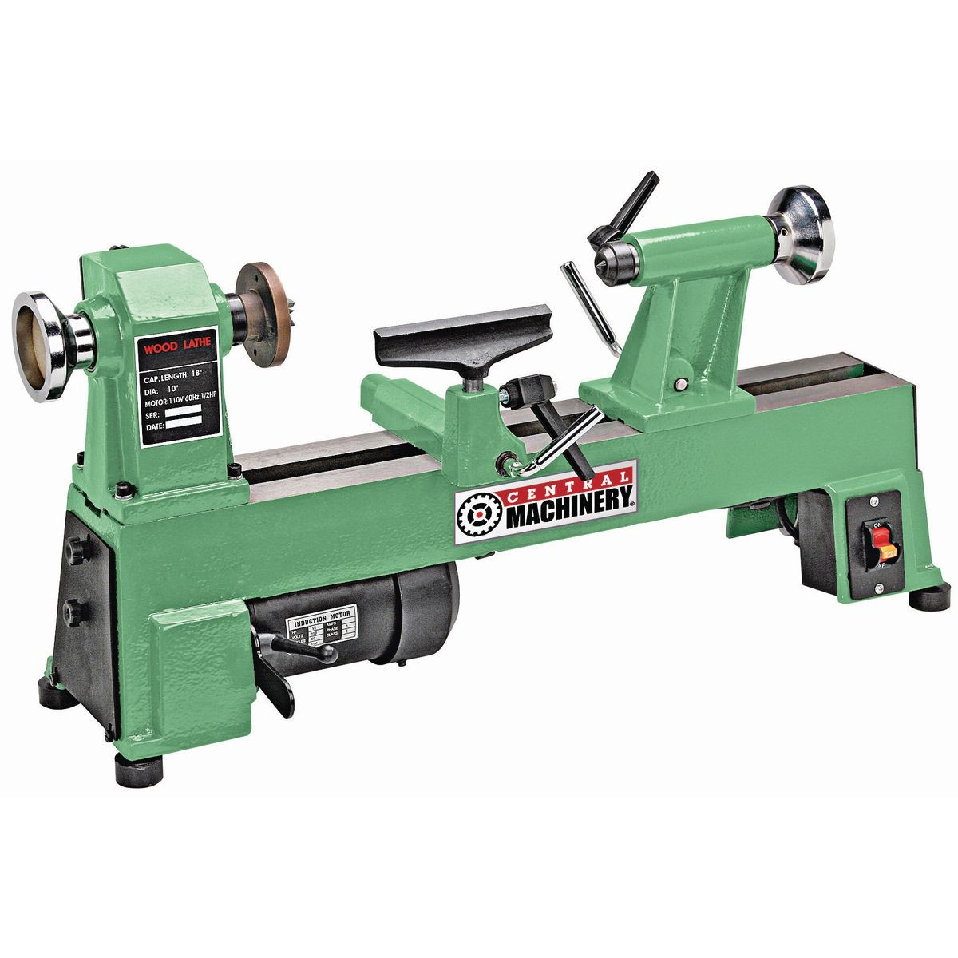
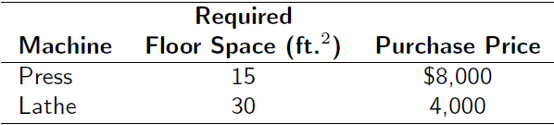
Ex: Total Integer Model
Machine shop owner is planning to expand by purchasing some new machines – presses and lathes
Owner estimated each press purchased will increase profit $100 per day, and each lathe purchased will increase profit $150 per day
Number of machines the owner can purchase is limited by the cost of the machines and available floor space

Slide 5
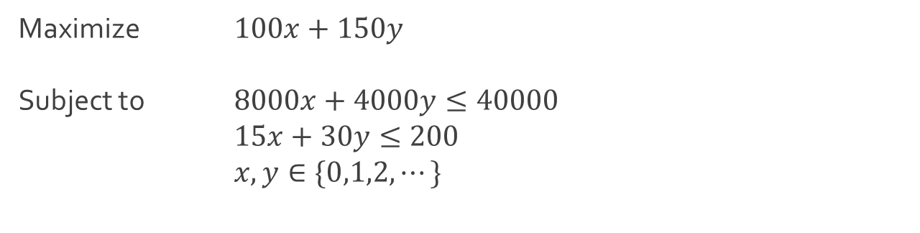
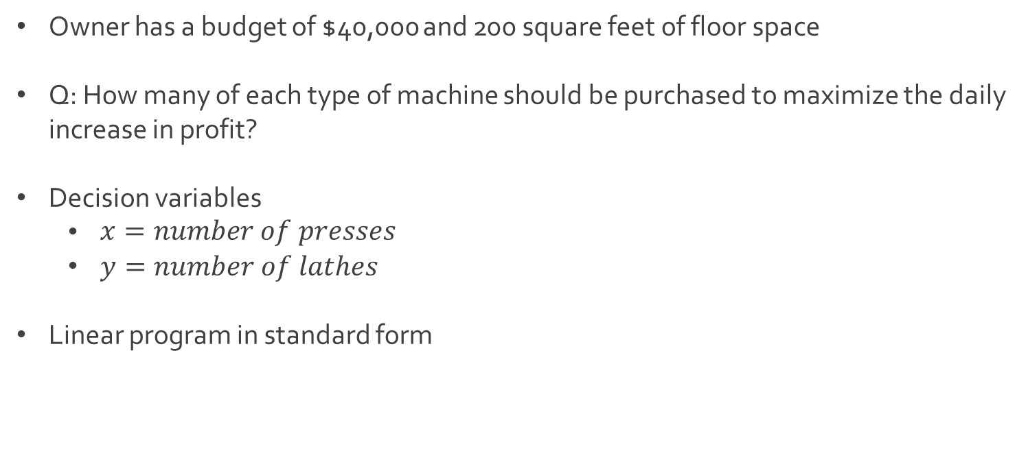
Ex: Total Integer Model
Owner has a budget of $40,000 and 200 square feet of floor space
Q: How many of each type of machine should be purchased to maximize the daily increase in profit?
Decision variables
$\begin{aligned}x=\#\#\#\#number\# of presses\end{aligned}$
$y=number of lathes$
Linear program in standard form
Maximize $100x+150y$
Subject to $8000x+4000y≤40000$
$15x+30y≤200$
$x,y∈\{0,1,2,⋯\}$

Slide 6
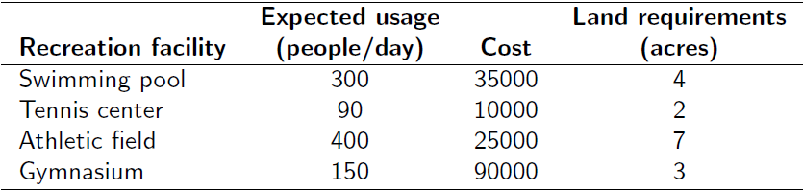
Ex: 0-1 Integer Model
Community council must decide which recreation facilities to construct
Swimming pool
Tennis center
Athletic field
Gymnasium
Q: Which facilities should be constructed to maximize daily usage?
Council’s decision is subject to land and cost limitations

Slide 7
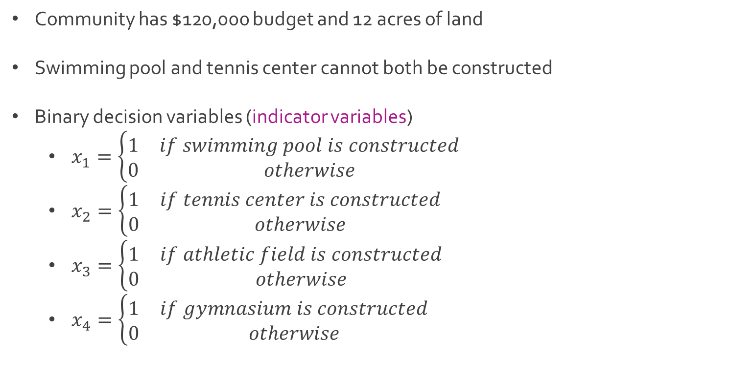
Ex: 0-1 Integer Model
Community has $120,000 budget and 12 acres of land
Swimming pool and tennis center cannot both be constructed
Binary decision variables (indicator variables)
$x_{1}=\left\{\begin{matrix}1 & if swimming pool is constructed \\ 0 & otherwise\end{matrix}\right.$
$x_{2}=\left\{\begin{matrix}1 & if tennis center is constructed \\ 0 & otherwise\end{matrix}\right.$
$x_{3}=\left\{\begin{matrix}1 & if athletic field is constructed \\ 0 & otherwise\end{matrix}\right.$
$x_{4}=\left\{\begin{matrix}1 & if gymnasium is constructed \\ 0 & otherwise\end{matrix}\right.$

Slide 8
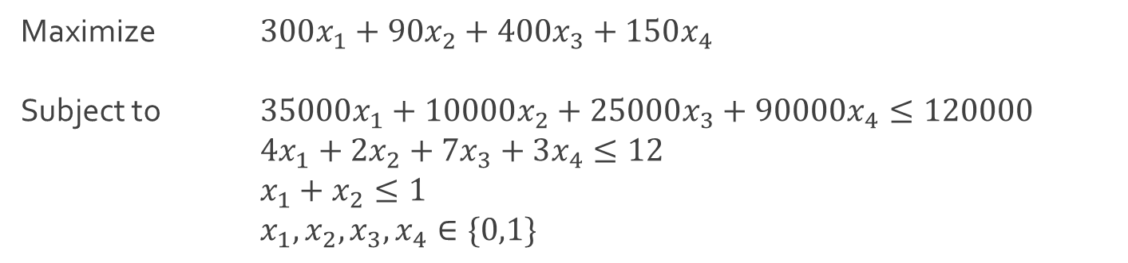

Ex: 0-1 Integer Model
Linear program in standard form
The constraint $x_{1}+x_{2}≤1$ is known as a mutually exclusive constraint which reflects the contingency that either the swimming pool or tennis center can be constructed but not both
Maximize $300x_{1}+90x_{2}+400x_{3}+150x_{4}$
Subject to $35000x_{1}+10000x_{2}+25000x_{3}+90000x_{4}≤120000$ $4x_{1}+2x_{2}+7x_{3}+3x_{4}≤12$
$x_{1}+x_{2}≤1$
$x_{1},x_{2},x_{3}, x_{4}∈\{0,1\}$

Slide 9
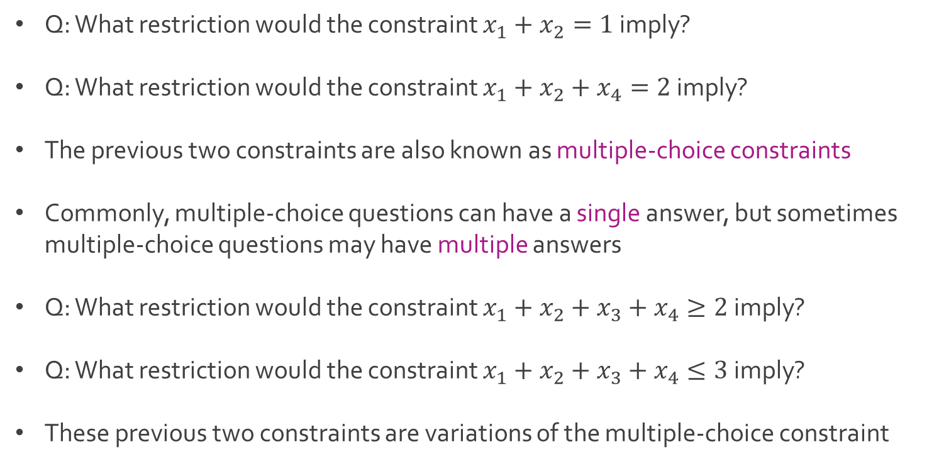
Ex: 0-1 Integer Model
Q: What restriction would the constraint $x_{1}+x_{2}=1$ imply?
Q: What restriction would the constraint $x_{1}+x_{2}+x_{4}=2$ imply?
The previous two constraints are also known as multiple-choice constraints
Commonly, multiple-choice questions can have a single answer, but sometimes multiple-choice questions may have multiple answers
Q: What restriction would the constraint $x_{1}+x_{2}+x_{3}+x_{4}≥2$ imply?
Q: What restriction would the constraint $x_{1}+x_{2}+x_{3}+x_{4}≤3$ imply?
These previous two constraints are variations of the multiple-choice constraint

Slide 10
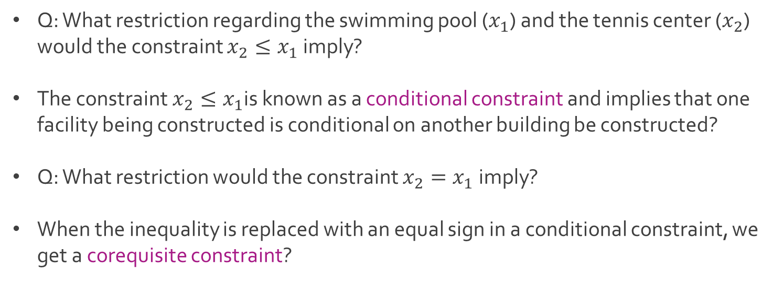
Ex: 0-1 Integer Model
Q: What restriction regarding the swimming pool ($x_{1}$) and the tennis center ($x_{2}$) would the constraint $x_{2}≤x_{1}$ imply?
The constraint $x_{2}≤x_{1}$is known as a conditional constraint and implies that one facility being constructed is conditional on another building be constructed?
Q: What restriction would the constraint $x_{2}=x_{1}$imply?
When the inequality is replaced with an equal sign in a conditional constraint, we get a corequisite constraint?

Slide 11
Ex: Mixed Integer Model
Nancy Smith has $250,000 to invest in 3 alternative investments for the year
Condominiums cost $50,000 and return $9,000 in 1 year
Land costs $12,000 per acre and will return $1,500 per acre in 1 year
Municipal bonds cost $8,000 and will return $1,000 in 1 year
Only 4 condominiums, 15 acres of land, and 20 municipal bonds available
Q: How many condominiums, acres of land, and municipal bonds should be purchased to maximize return?
Q: How is this an example of a mixed integer model?

Slide 12
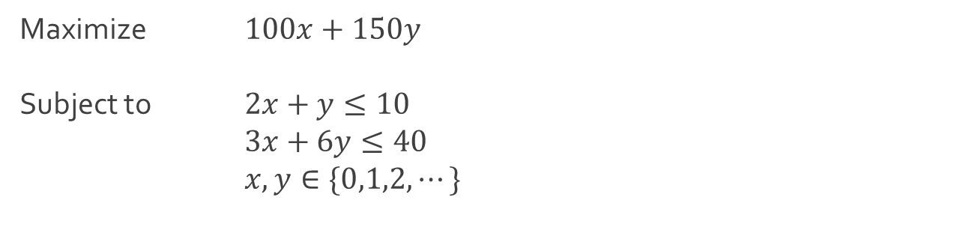
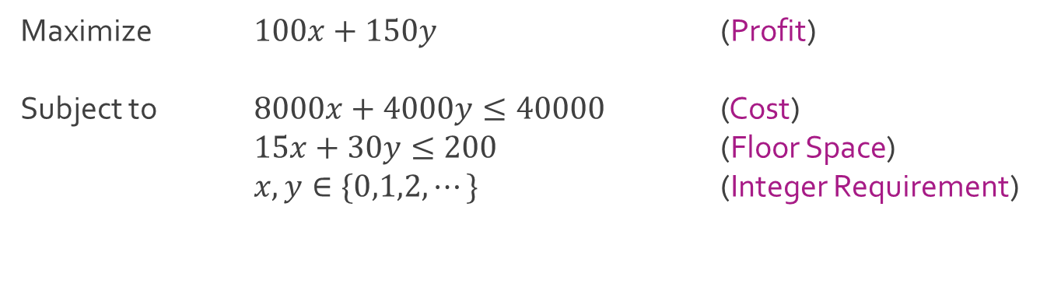
Ex: Machine Shop
Linear program in standard form
Simplified linear program in standard form
Maximize $100x+150y$ (Profit)
Subject to $8000x+4000y≤40000$ (Cost)
$15x+30y≤200$ (Floor Space)
$x,y∈\{0,1,2,⋯\}$ (Integer Requirement)
Maximize $100x+150y$
Subject to $2x+y≤10$
$3x+6y≤40$
$x,y∈\{0,1,2,⋯\}$

Slide 13
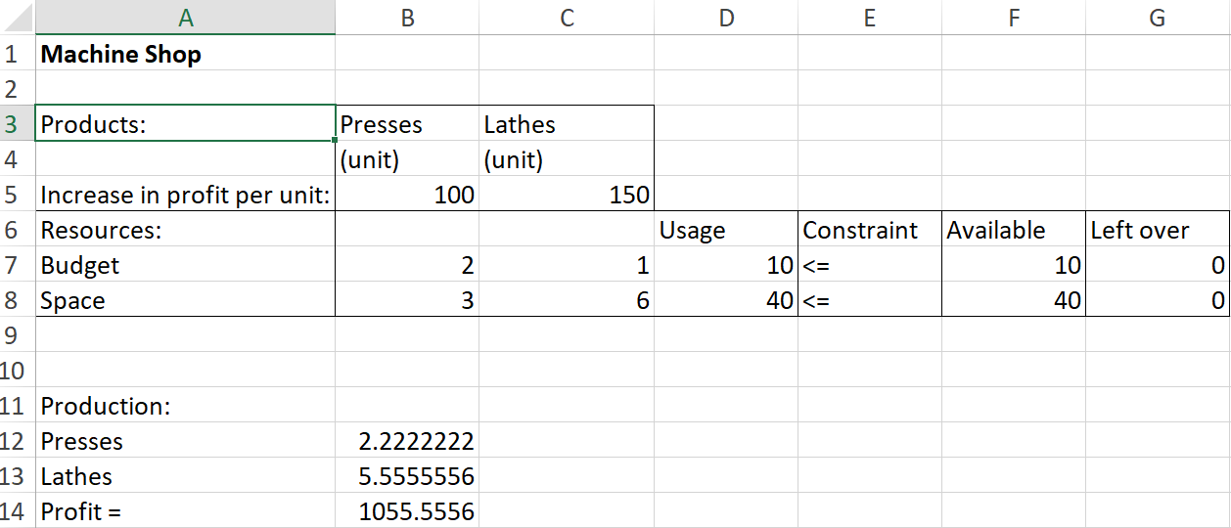
Ex: Machine Shop
Download MachineShop.xlsx from course website from link Sheet 1
Q:What is the problem with the optimal solution?

Slide 14
Ex: Machine Shop
We could fix the problem by rounding to the nearest integer
The problem is the point may be infeasible
We could fix the problem by rounding down
This point is feasible but may not be optimal
No clear rule on how to round the solution to acquire the optimal solution for the integer programming model
$\left(2.222,5.556\right)→(2,6)$
$3\left(2\right)+6\left(6\right)=42≥40$
$\left(2.222,5.556\right)→(2,5)$
$100\left(2\right)+150\left(5\right)=\$950$

Slide 15
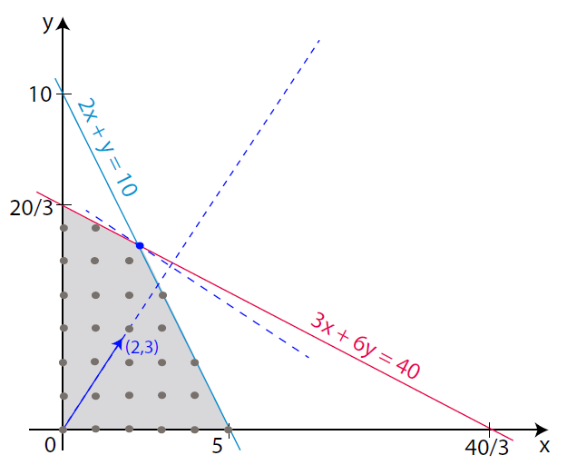
Ex: Machine Shop
Graphical solution

Slide 16

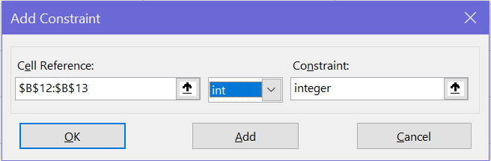

Ex: Machine Shop
Finding optimal integer solution from Excel Solver

Slide 17
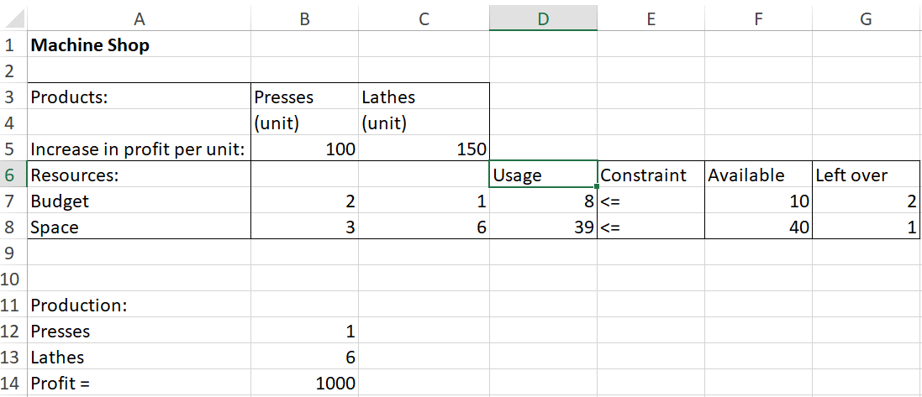
Ex: Machine Shop
Optimal solution to integer programming model

Slide 18




The End
Dale

